Slide 1
Algorithms and Data Structures
Lecture IV
Simonas Šaltenis
Nykredit Center for Database Research
Aalborg University
simas@cs.auc.dk

Slide 2
This Lecture
Sorting algorithms
Quicksort
  a popular algorithm, very fast on average
Heapsort
  Heap data structure and priority queue ADT

Slide 3
Why Sorting?
“When in doubt, sort” – one of the principles of algorithm design. Sorting used as a subroutine in many of the algorithms:
  Searching in databases: we can do binary search on sorted data
  A large number of computer graphics and computational geometry problems
  Closest pair, element uniqueness

Slide 4
Why Sorting? (2)
A large number of sorting algorithms are developed representing different algorithm design techniques.
A lower bound for sorting Ω(n log n) is used to prove lower bounds of other problems

Slide 5
Sorting Algorithms so far
Insertion sort, selection sort
  Worst-case running time Θ(n²); in-place
Merge sort
  Worst-case running time Θ(n log n), but requires additional memory Θ(n);

Slide 6
Quick Sort
Characteristics
  sorts almost in "place," i.e., does not require an additional array
  like insertion sort, unlike merge sort
  very practical, average sort performance O(n log n) (with small constant factors), but worst case O(n²)

Slide 7
Quick Sort – the Principle
To understand quick-sort, let’s look at a high-level description of the algorithm
A divide-and-conquer algorithm
  Divide: partition array into 2 subarrays such that elements in the lower part <= elements in the higher part
  Conquer: recursively sort the 2 subarrays
  Combine: trivial since sorting is done in place

Slide 8
Partitioning
Linear time partitioning procedure
i
i
j
j
Partition(A,p,r)
01 x←A[r]
02 i←p-1
03 j←r+1
04 while TRUE
05 repeat j←j-1
06 until A[j] ≤x
07 repeat i←i+1
08 until A[i] ≥x
09 if i<j
10 then exchange A[i]↔A[j]
11 else return j
17 | 12 | 6 | 19 | 23 | 8 | 5 | 10
 | ≤ X=10 ≤
i
j
10 | 12 | 6 | 19 | 23 | 8 | 5 | 17
i
j
10 | 5 | 6 | 19 | 23 | 8 | 12 | 17
j
i
10 | 5 | 6 | 8 | 23 | 19 | 12 | 17
10 | 5 | 6 | 8 | 23 | 19 | 12 | 17

Slide 9
Quick Sort Algorithm
Initial call Quicksort(A, 1, length[A])
Quicksort(A,p,r)
01 if p<r
02 then q←Partition(A,p,r)
03 Quicksort(A,p,q)
04 Quicksort(A,q+1,r)

Slide 10
Analysis of Quicksort
Assume that all input elements are distinct
The running time depends on the distribution of splits

Slide 11
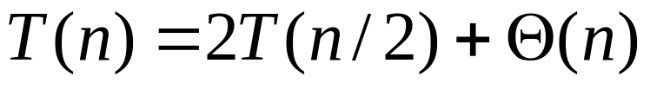
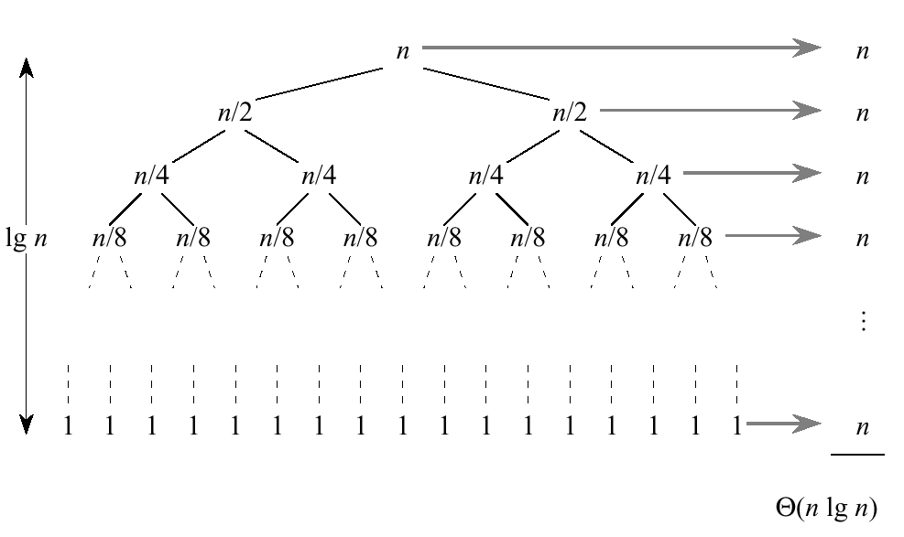
Best Case
If we are lucky, Partition splits the array evenly

Slide 12
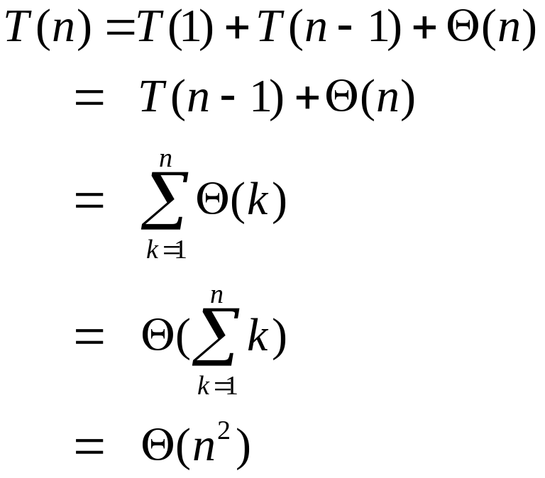
Worst Case
What is the worst case?
One side of the parition has only one element

Slide 13
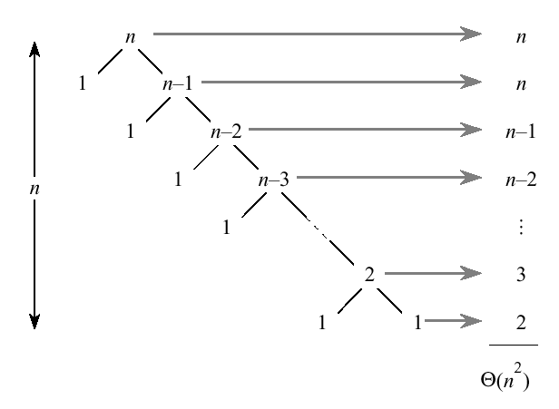
Worst Case (2)

Slide 14
Worst Case (3)
When does the worst case appear?
  input is sorted
  input reverse sorted
Same recurrence for the worst case of insertion sort
However, sorted input yields the best case for insertion sort!

Slide 15
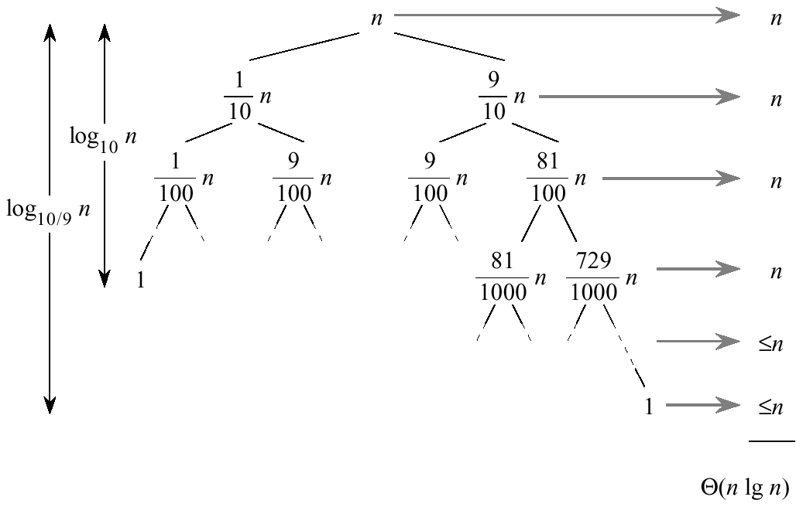
Analysis of Quicksort
Suppose the split is 1/10 : 9/10

Slide 16
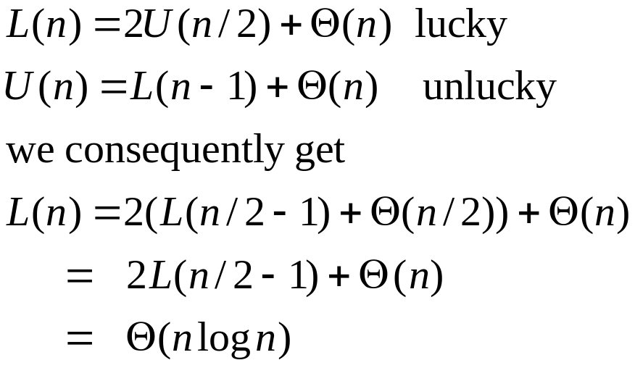
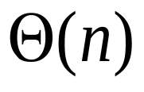
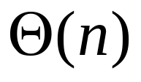
An Average Case Scenario
Suppose, we alternate lucky and unlucky cases to get an average behavior
n
n
1
n-1
(n-1)/2
(n-1)/2
(n-1)/2+1
(n-1)/2
Notes:
larger constant in the O notation

Slide 17
An Average Case Scenario (2)
How can we make sure that we are usually lucky?
  Partition around the ”middle” (n/2th) element?
  Partition around a random element (works well in practice)
Randomized algorithm
  running time is independent of the input ordering
  no specific input triggers worst-case behavior
  the worst-case is only determined by the output of the random-number generator

Slide 18
Randomized Quicksort
Assume all elements are distinct
Partition around a random element
Consequently, all splits (1:n-1, 2:n-2, ..., n-1:1) are equally likely with probability 1/n
Randomization is a general tool to improve algorithms with bad worst-case but good average-case complexity

Slide 19
Randomized Quicksort (2)
Randomized-Partition(A,p,r)
01 i←Random(p,r)
02 exchange A[r] ↔A[i]
03 return Partition(A,p,r)
Randomized-Quicksort(A,p,r)
01 if p<r then
02 q←Randomized-Partition(A,p,r)
03 Randomized-Quicksort(A,p,q)
04 Randomized-Quicksort(A,q+1,r)

Slide 20
Selection Sort
Selection-Sort(A[1..n]):
For i → n downto 2
A: Find the largest element among A[1..i] B: Exchange it with A[i]
A takes Θ(n) and B takes Θ(1): Θ(n²) in total
Idea for improvement: use a data structure, to do both A and B in O(lg n) time, balancing the work, achieving a better trade-off, and a total running time O(n log n)

Slide 21
Heap Sort
Binary heap data structure A
  array
  Can be viewed as a nearly complete binary tree
    All levels, except the lowest one are completely filled
  The key in root is greater or equal than all its children, and the left and right subtrees are again binary heaps
Two attributes
  length[A]
  heap-size[A]

Slide 22
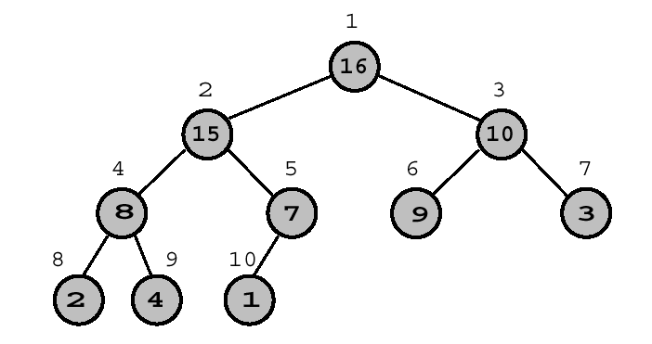
Heap Sort (3)
Parent (i)
return ⎣i/2⎦
Left (i)
return 2i
Right (i)
return 2i+1
Heap propertiy:
A[Parent(i)] ≥ A[i]
1 | 2 | 3 | 4 | 5 | 6 | 7 | 8 | 9 | 10
16 | 15 | 10 | 8 | 7 | 9 | 3 | 2 | 4 | 1
Level: 3 2 1 0

Slide 23
Heap Sort (4)
Notice the implicit tree links; children of node i are 2i and 2i+1
Why is this useful?
  In a binary representation, a multiplication/division by two is left/right shift
  Adding 1 can be done by adding the lowest bit

Slide 24
Heapify
i is index into the array A
Binary trees rooted at Left(i) and Right(i) are heaps
But, A[i] might be smaller than its children, thus violating the heap property
The method Heapify makes A a heap once more by moving A[i] down the heap until the heap property is satisfied again

Slide 25
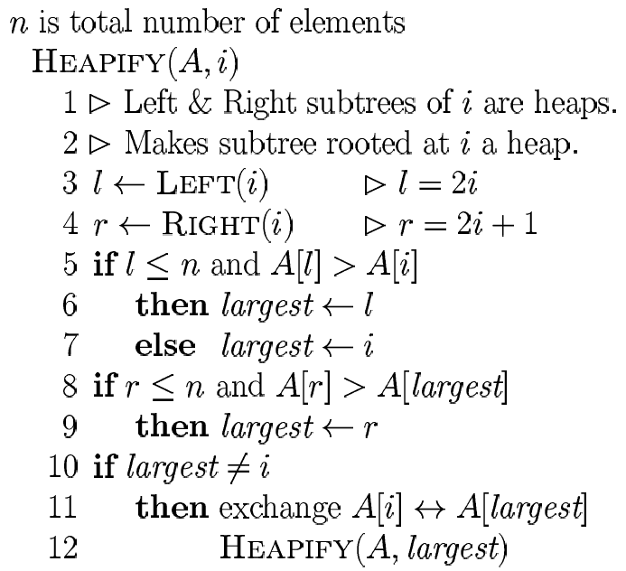
Heapify (2)

Slide 26
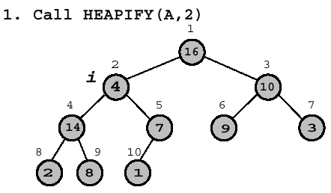

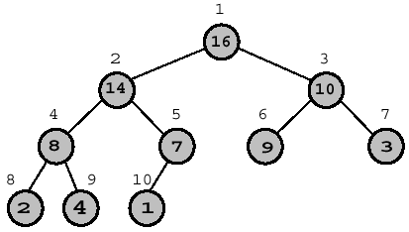
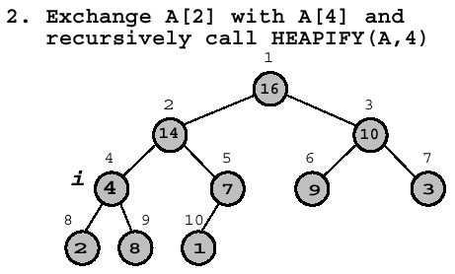

Heapify Example

Slide 27
Heapify: Running Time
The running time of Heapify on a subtree of size n rooted at node i is
  determining the relationship between elements: Θ(1)
  plus the time to run Heapify on a subtree rooted at one of the children of i, where 2n/3 is the worst-case size of this subtree.
  Alternatively
    Running time on a node of height h: O(h)

Slide 28
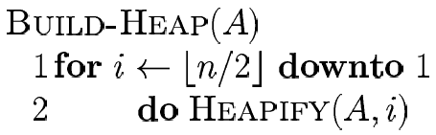
Building a Heap
Convert an array A[1...n], where n = length[A], into a heap
Notice that the elements in the subarray A[(⎣n/2⎦ + 1)...n] are already 1-element heaps to begin with!

Slide 29
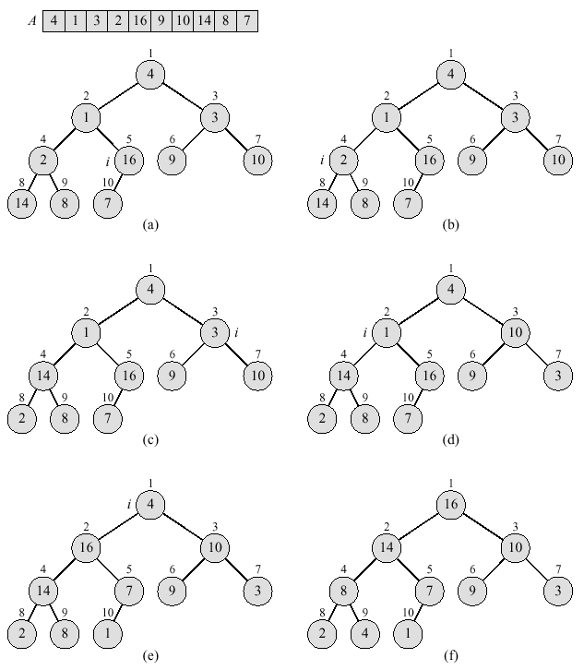
Building a Heap

Slide 30
Building a Heap: Analysis
Correctness: induction on i, all trees rooted at m > i are heaps
Running time: n calls to Heapify = n O(lg n) = O(n lg n)
Good enough for an O(n lg n) bound on Heapsort, but sometimes we build heaps for other reasons, would be nice to have a tight bound
  Intuition: for most of the time Heapify works on smaller than n element heaps

Slide 31
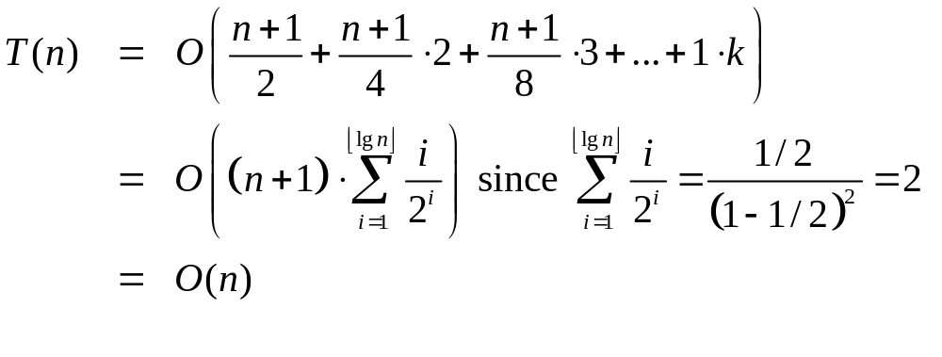
Building a Heap: Analysis (2)
Definitions
  height of node: longest path from node to leaf
  height of tree: height of root
  time to Heapify = O(height of subtree rooted at i)
  assume n = 2^{k} – 1 (a complete binary tree k = ⎣lg n⎦)

Slide 32
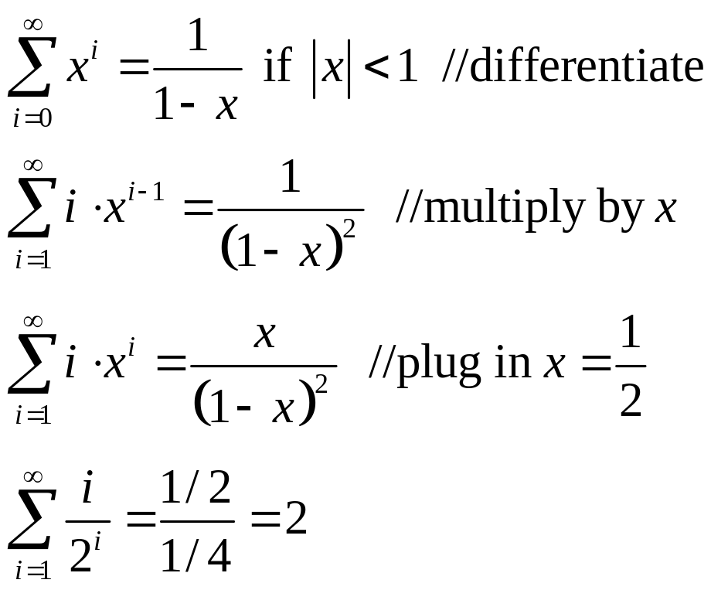
Building a Heap: Analysis (3)
How? By using the following "trick"
Therefore Build-Heap time is O(n)

Slide 33
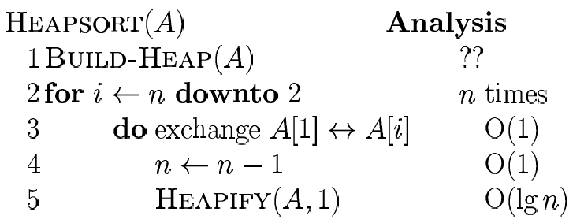

Heap Sort
The total running time of heap sort is O(n lg n) + Build-Heap(A) time, which is O(n)

Slide 34
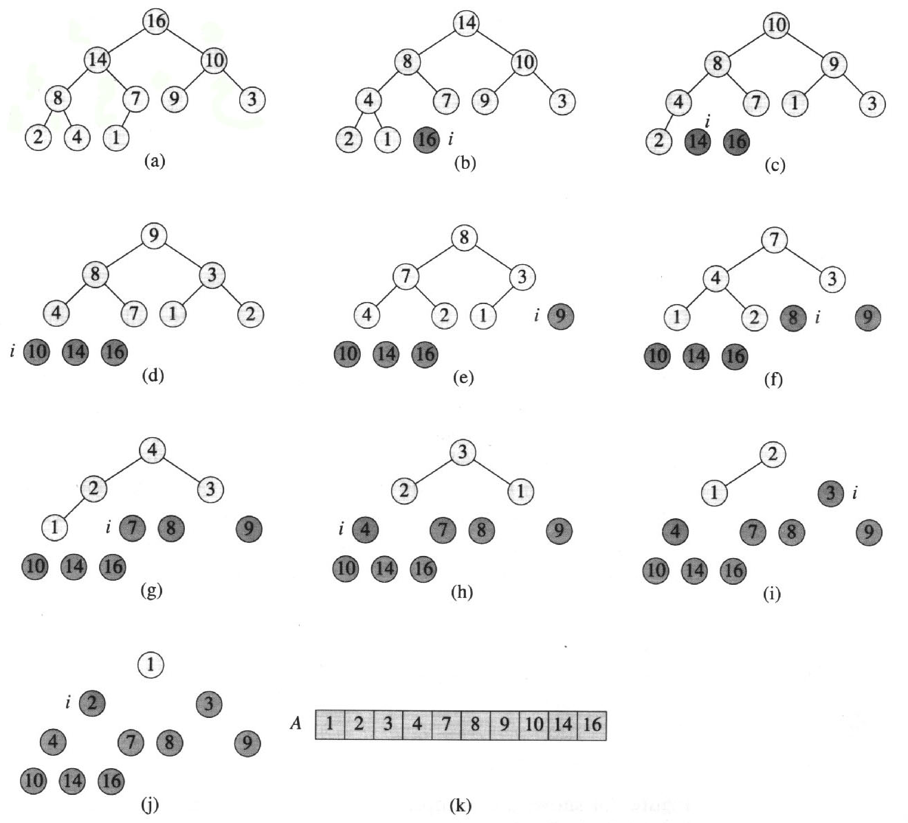
Heap Sort

Slide 35
Heap Sort: Summary
Heap sort uses a heap data structure to improve selection sort and make the running time asymptotically optimal
Running time is O(n log n) – like merge sort, but unlike selection, insertion, or bubble sorts
Sorts in place – like insertion, selection or bubble sorts, but unlike merge sort

Slide 36
Priority Queues
A priority queue is an ADT(abstract data type) for maintaining a set S of elements, each with an associated value called key
A PQ supports the following operations
  Insert(S,x) insert element x in set S (S←S∪{x})
  Maximum(S) returns the element of S with the largest key
  Extract-Max(S) returns and removes the element of S with the largest key

Slide 37
Priority Queues (2)
Applications:
  job scheduling shared computing resources (Unix)
  Event simulation
  As a building block for other algorithms
A Heap can be used to implement a PQ

Slide 38
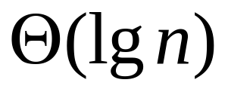
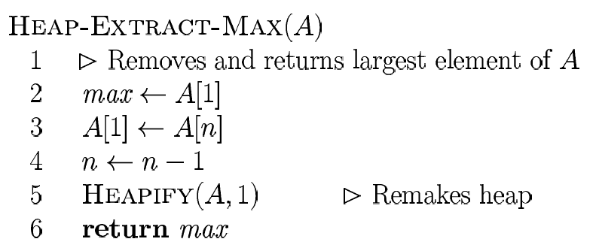
Priority Queues (3)
Removal of max takes constant time on top of Heapify

Slide 39
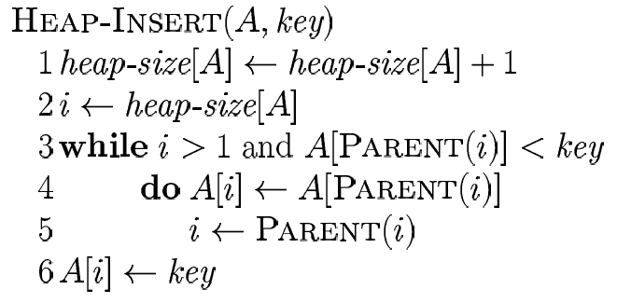
Priority Queues (4)
Insertion of a new element
  enlarge the PQ and propagate the new element from last place ”up” the PQ
  tree is of height lg n, running time:

Slide 40
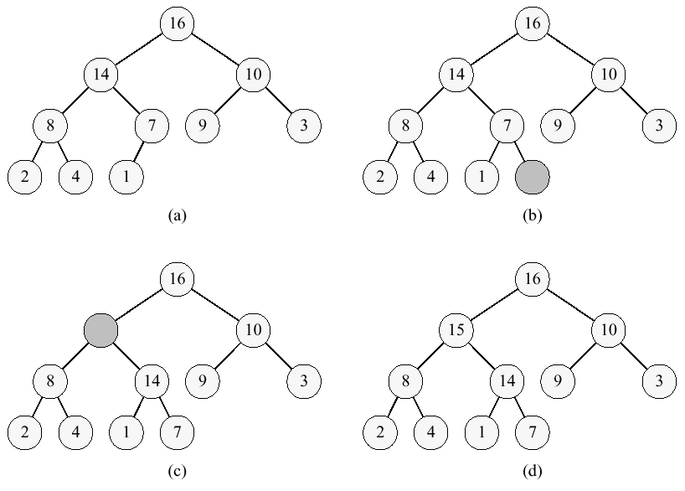
Priority Queues (5)

Slide 41
Next Week
ADTs and Data Structures
  Definition of ADTs
  Elementary data structures
  Trees

